Slide 1

Analysis of in Singapore
By Figia Cantikasari Giyana

Slide 2
Table of CONTENT
About Me
Project Background
Tools
Problem Definition
Data Understanding
Data Cleaning
Insights

Slide 3

Hello, im Figia!
I am bachelor of mathematic graduate from UIN Syarif Hidayatullah Jakarta with competency skills focused on statistics. Enjoy working with data and able to find insights from the data. In addition, I have completed the Data Analytics with Python and SQL Bootcamp at DQLab which is provided me with skills in business problem definition, SQL, Python, and data visualization.

Slide 4
Project Background
A‌i‌r‌b‌n‌b‌ is an online marketplace connects people looking for lodging, primarily homestays, or tourism experiences to hosts of spaces available for rent. Before the pandemic situation hit the global tourism industry, the Airbnb grow rapidly in Singapore and generated a highly comprehensive data within Southeast Asia.
So for this project, the dataset provided was Airbnb listings in Singapore from the year 2018 until 2022. Data provided includes detailed data per listing, historical rental data per listing, and neighbourhood_group mapping for each neighbourhood.

Slide 5




The tools that I used :

Slide 6
Points to analyze :
Trend: how the trend number of reviews looks like throughout January 2018 until September 2022 ?
Location: how each region stacks up against one another in pricing and number of reviews ?
Room type: how the number of reviews by room type of listings ?

Slide 7
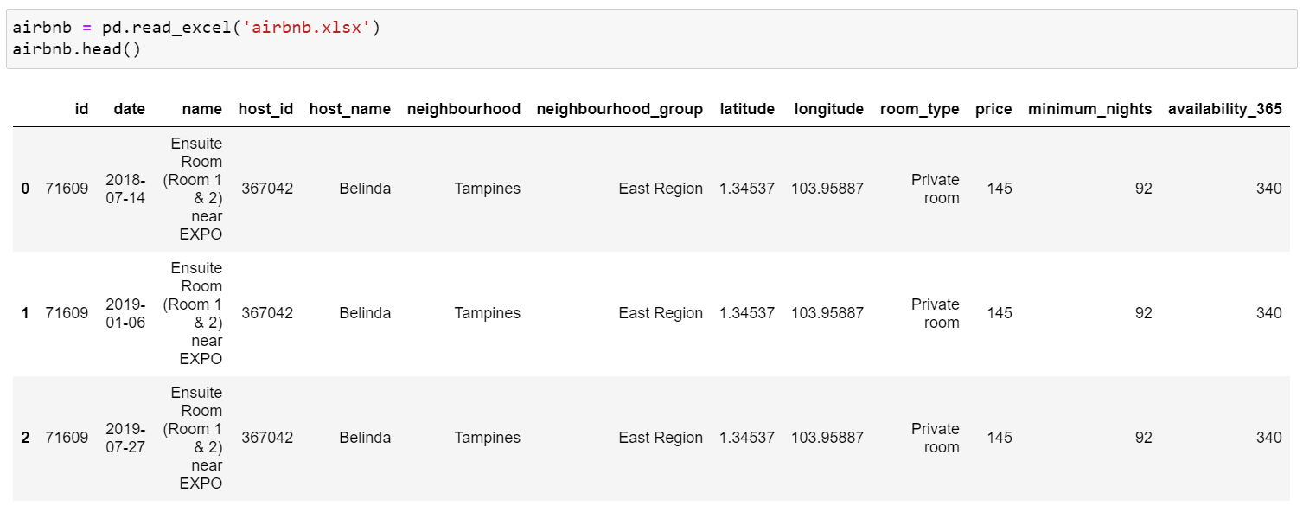
Data Understanding
First of all, we joined all data we have using SQL.
And then using Python we import library pandas and load the dataset.

Slide 8
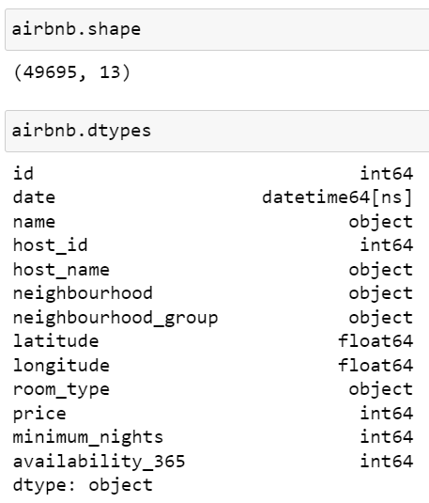
After we load the dataset, we need to understand the dataset by using various techniques. First, we need to look for information on how big is our dataset. By using shape attributes, we get to know our data size from a number of rows which consist of listing index, and the number of columns with the content of every features related to the index.
We found out our dataset has 49695 listings and have 13 features. And all the data type of every column already matches with our requirement.

Slide 9
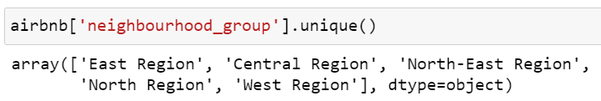
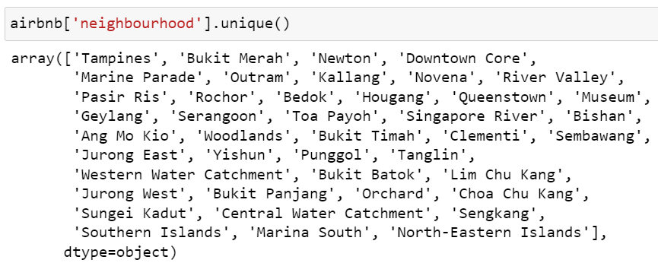
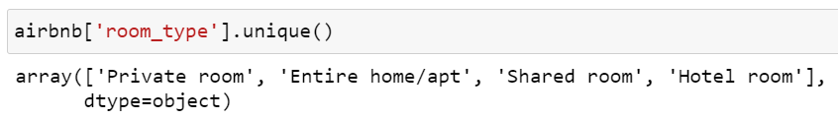
Next, we look up all the unique values of the ‘neighbourhood_group’ that is consists of a list of all the Singapore region.
From the list beside, we see that Singapore has 5 region area.
And, we look up all the unique values of the ‘neighbourhood’ to look at which area that has the Airbnb listing.
Now, we know that 42 areas have the Airbnb listing.
We also look up the ‘room_type’ columns for each room type of the listing.
From the list beside, we see that Airbnb have 4 room type.

Slide 10
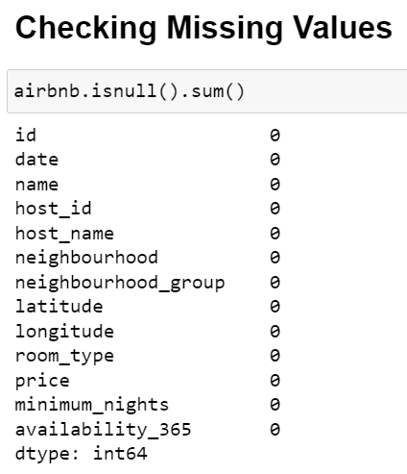
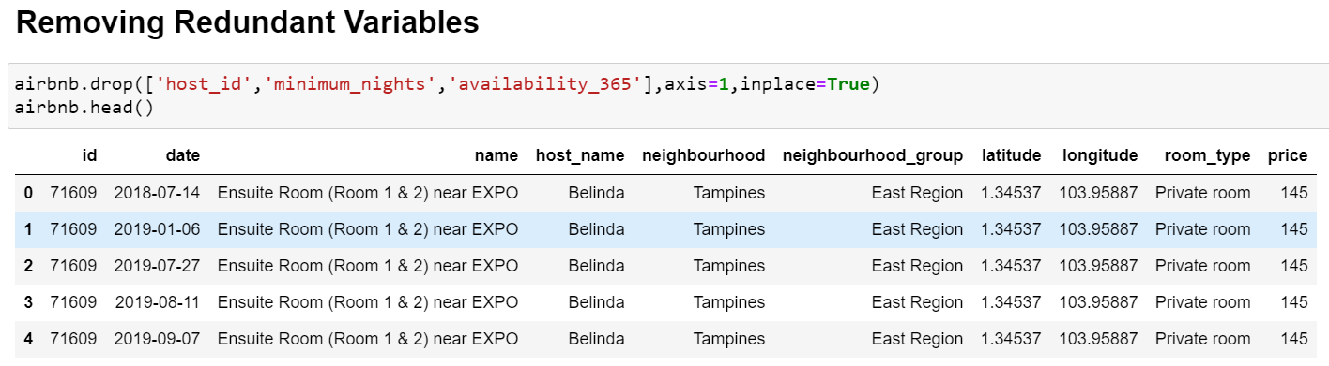
Data Cleaning
The next step is cleaning up the data, by doing this the data quality will have better quality to be used for further analysis.

Slide 11
INSIGHTS

Slide 12
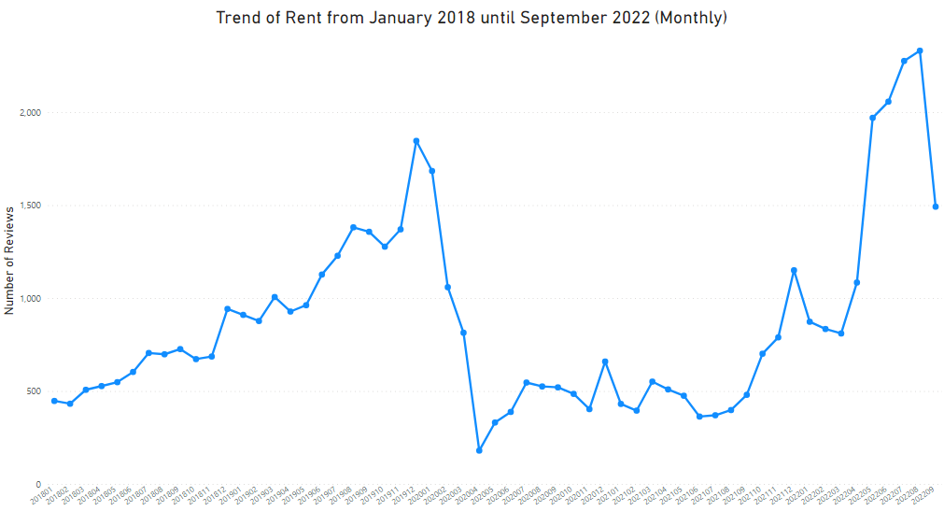
Chart 1
Aug 2022
2331 listings
Dec 2019
1846 listings
Apr 2020
180 listings

Slide 13
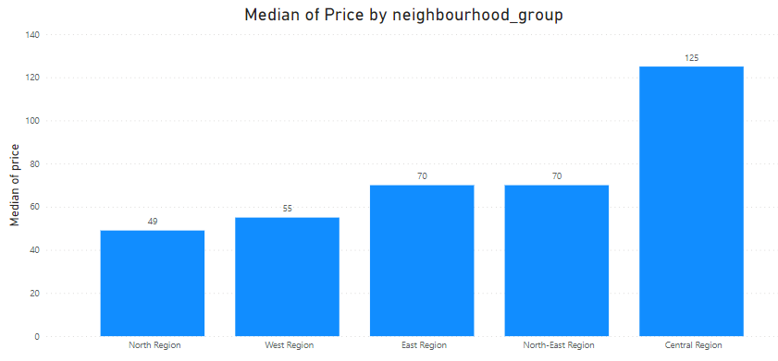
Chart 2

Slide 14
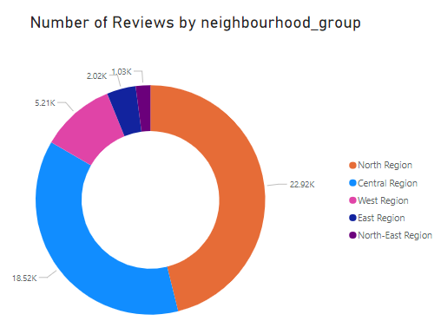
Chart 3

Slide 15
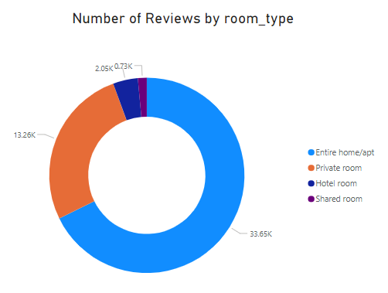
Chart 4

Slide 16
KEY INSIGHTS

Slide 17
Insight #1 : Trend
The listing trend in Chart 1 from January 2018 until September 2022 has some interesting points. The trend goes upward until late 2019, when it began to free fall from 1846 listings in December 2019 to just 180 listings in April 2020 (impact Covid-19 pandemic), before it finally steadily rises again up to 2331 listings in August 2022.

Slide 18
Insight #2 : Location
The median of prices by neighborhood group are shown in Chart 2, with Central Region being the highest at 125 and North Region being the lowest at 49. When we look at occupancy rates, the North Region comes out on top as can be seen on Chart 3 (because of it offers affordable price).

Slide 19
Insight #3 : Room type
Moving on to Chart 4, we can see that the most reviewed room type is the “Entire home/apt” room type and “Shared room” being the least reviewed.

